Slide 1
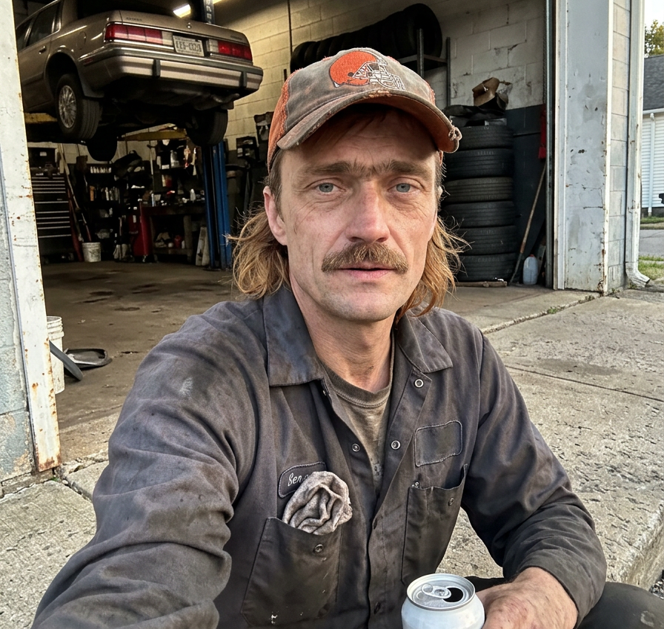

DIGITAL FAN EXPANSION CONCEPT
GROWING
THE CROWD
Persistent characters can turn a scrolling audience into a returning fan community.
Built from the new character reel / October 2026
NOT REAL FANS / DIGITAL FAN EXPANSION CONCEPT
CONCEPT ONLY / NO TEAM OR LEAGUE AFFILIATION
01
Notes:
Purpose: introduce a non-financial concept for expanding the fanbase through recurring digital characters and participation.
Higgsfield-created image: /Users/mcricks/Desktop/AI/NFL/assets/Browns/hf_20261009_144042_a5ff3c3d-98b5-4388-a53e-8f53e659f8b8.png
Brand asset: /Users/mcricks/Desktop/AI/NFL/AI_Influencer_Studio/Brand/Logo_Exploration/v2-mechanical-fan/not-real-fans-primary-transparent.png

Slide 2
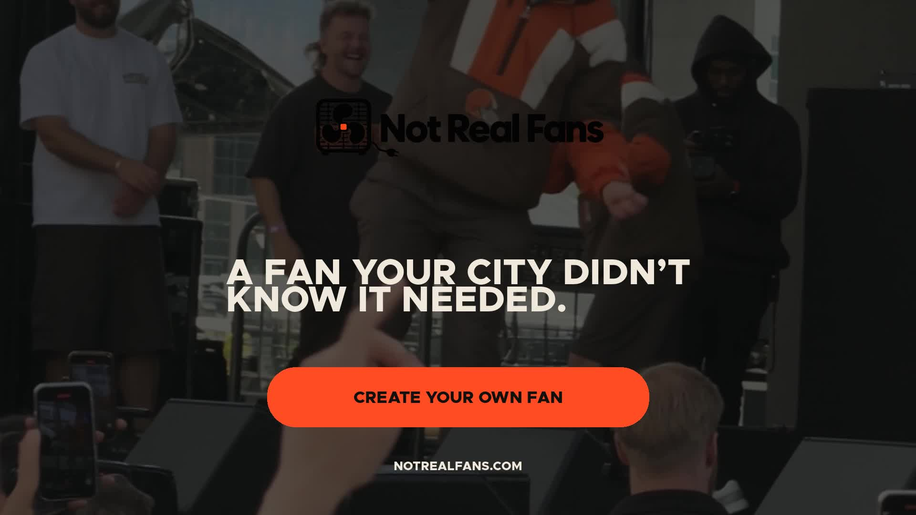
THE REEL CONCEPT
A LOCAL CHARACTER
OPENS THE DOOR
The new reel introduces Daz as someone the audience can recognize, remember and eventually influence.
The idea scales because the character carries history from one post to the next. The feed becomes an ongoing story instead of a stream of unrelated clips.
THE REEL'S PROMISE
A fan your city did not know it needed.
WATCH THE 30-SECOND HYPE VIDEO ↗
NOT REAL FANS / DIGITAL FAN EXPANSION CONCEPT
CONCEPT ONLY / NO TEAM OR LEAGUE AFFILIATION
02
Notes:
Concept source: /Users/mcricks/Desktop/AI/NFL/AI_Influencer_Studio/Business/Not_Real_Fans_Investment_Deck/trailer/exports/Not_Real_Fans_Character_Pitch_v2.mp4
Reel cover: /Users/mcricks/Desktop/AI/NFL/AI_Influencer_Studio/Business/Not_Real_Fans_Investment_Deck/trailer/exports/Not_Real_Fans_Character_Pitch_v2_Cover.jpg
Clickable hype-video link: file:///Users/mcricks/Desktop/AI/NFL/AI_Influencer_Studio/Business/Not_Real_Fans_Investment_Deck/trailer/exports/Not_Real_Fans_Character_Pitch_v2.mp4
The deck extends the reel's character-first premise into an audience growth model.

Slide 3
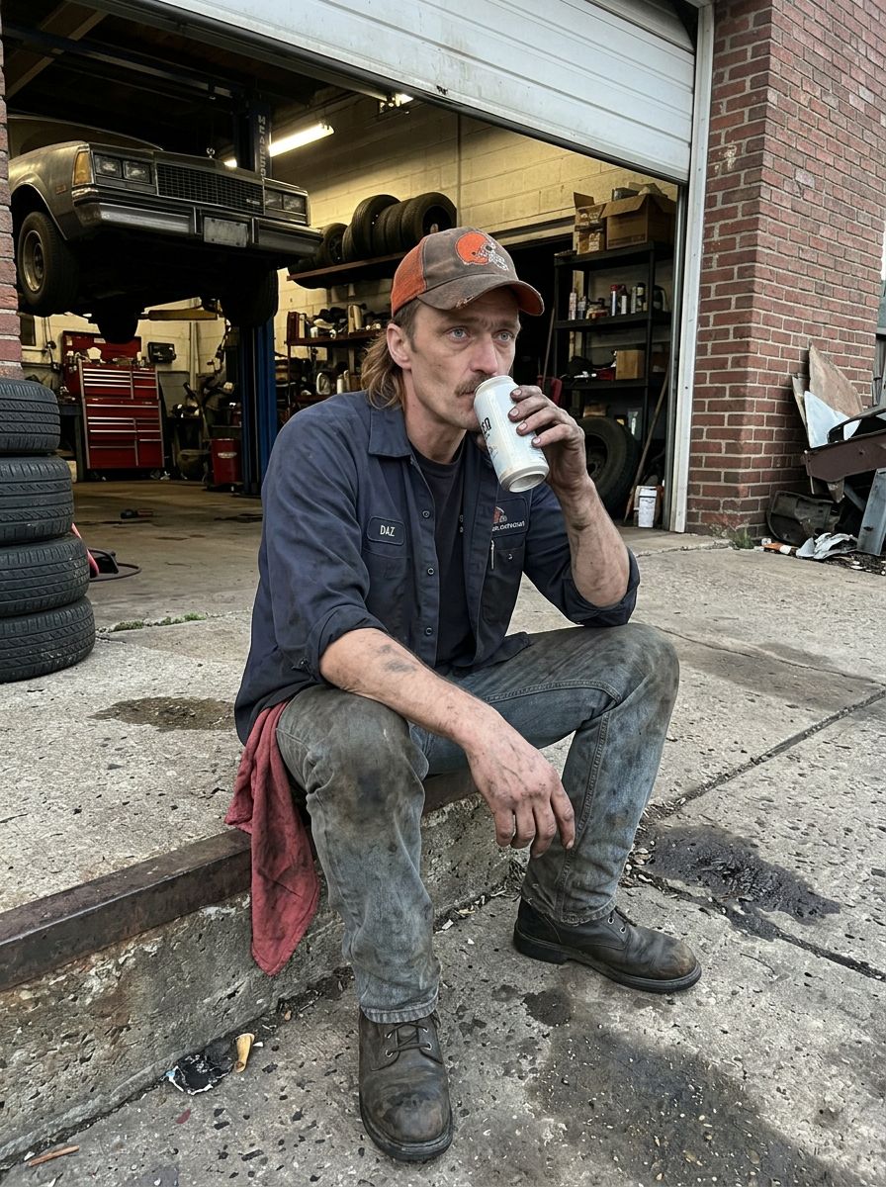
THE OPENING
FANDOM LIVES
BETWEEN GAMES
Game day creates the spike. Character stories keep the relationship alive during the rest of the week.
01
AFTER THE FINAL WHISTLE
A reaction that carries the emotion forward.
02
THE WEEKDAY ROUTINE
Work, family and neighborhood life make the fan recognizable.
03
RIVALRY AND FRIENDSHIP
Recurring relationships give every post more context.
04
SEASON MEMORY
Old choices and old losses remain part of the next episode.
NOT REAL FANS / DIGITAL FAN EXPANSION CONCEPT
CONCEPT ONLY / NO TEAM OR LEAGUE AFFILIATION
03
Notes:
Concept framing: recurring character content fills the cultural space between live events.
Higgsfield-created image: /Users/mcricks/Desktop/AI/NFL/assets/Browns/hf_20261009_050647_8f20b443-0bc5-45b8-84a7-5b5a5bdb916e.png

Slide 4
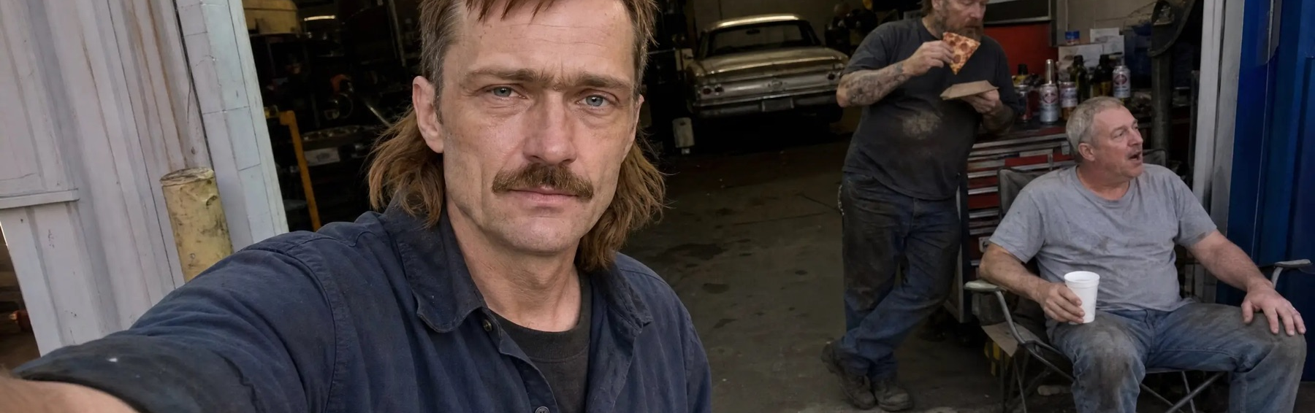
THE HABIT ENGINE
A RECURRING CHARACTER
GIVES THE FEED MEMORY
The audience returns because yesterday still matters.
SAME FACE
SAME CITY
PAST CHOICES
NEXT CONSEQUENCE
Recognition
Local texture
Continuity
Anticipation
The character bible protects the details that make recognition possible. Each new post adds another reason to know him.
The reel proves the tone. The ongoing series proves the habit.
DAZ PROFILE ↗
@SMOKEDAWGCLE ↗
NOT REAL FANS / DIGITAL FAN EXPANSION CONCEPT
CONCEPT ONLY / NO TEAM OR LEAGUE AFFILIATION
04
Notes:
Character continuity concept based on the approved Not Real Fans character-bible workflow.
Image: /Users/mcricks/Desktop/AI/NFL/AI_Influencer_Studio/Website/not-real-fans/public/characters/cleveland-ohio-darren-daz-krawczyk/shop.jpg
Daz profile: https://notrealfans.com/fans.html
Daz Instagram: https://www.instagram.com/smokedawgcle/

Slide 5
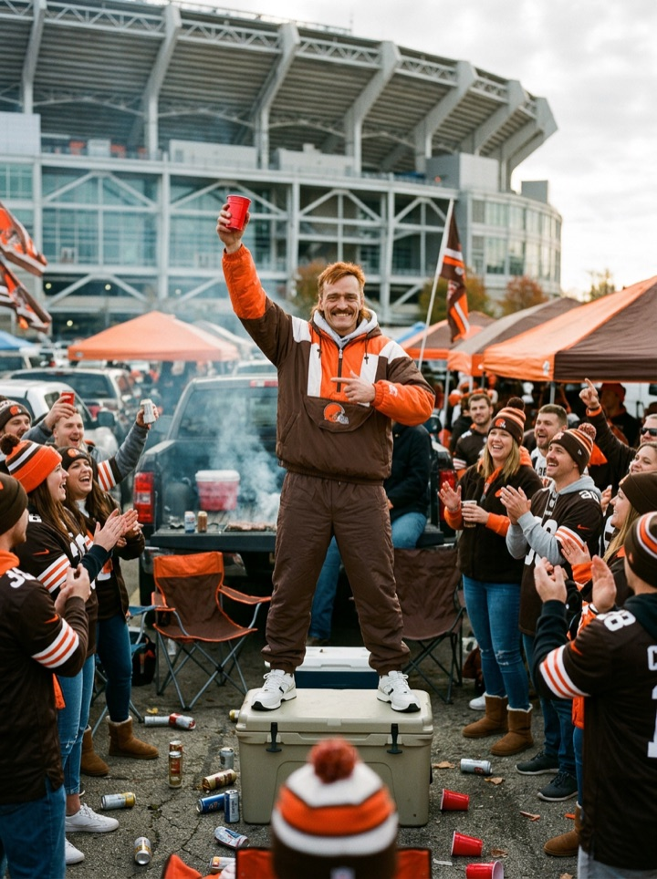
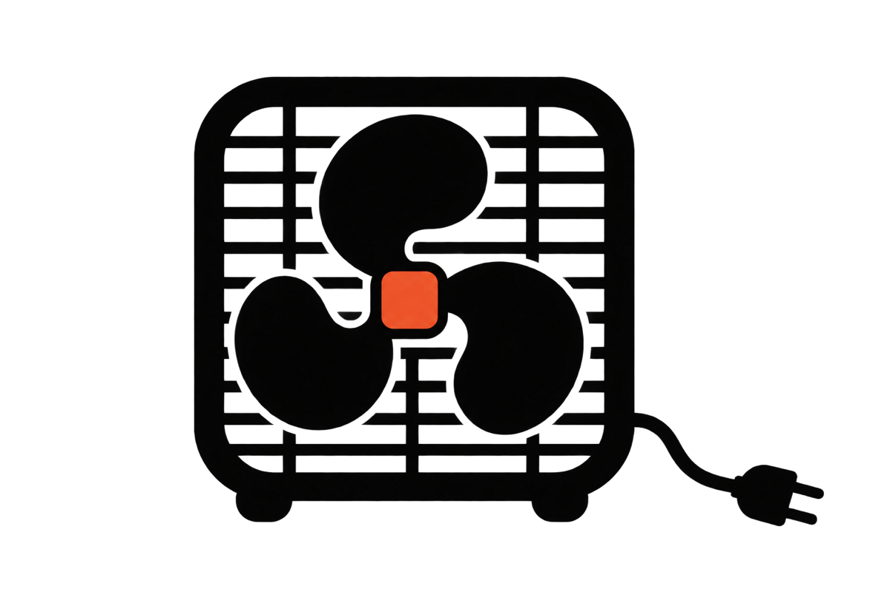
THE PARTICIPATION LOOP
THE CROWD
JOINS THE STORY
Participation gives the audience a visible stake without giving up continuity.
01
WATCH
Meet the character in a short, specific moment.
02
CREATE
Submit a line, ritual, conflict or next episode idea.
03
VOTE
Signal which ideas deserve another chapter.
04
ENTER CANON
The strongest approved ideas become part of the world.
NOT REAL FANS / DIGITAL FAN EXPANSION CONCEPT
CONCEPT ONLY / NO TEAM OR LEAGUE AFFILIATION
05
Notes:
Concept only: the audience participation loop remains moderated and does not imply a launched product.
Higgsfield-created image: /Users/mcricks/Desktop/AI/NFL/AI_Influencer_Studio/Website/not-real-fans/public/fragments/crowd-01.jpg
Brand asset: /Users/mcricks/Desktop/AI/NFL/AI_Influencer_Studio/Brand/Logo_Exploration/v2-mechanical-fan/not-real-fans-box-fan-transparent.png

Slide 6
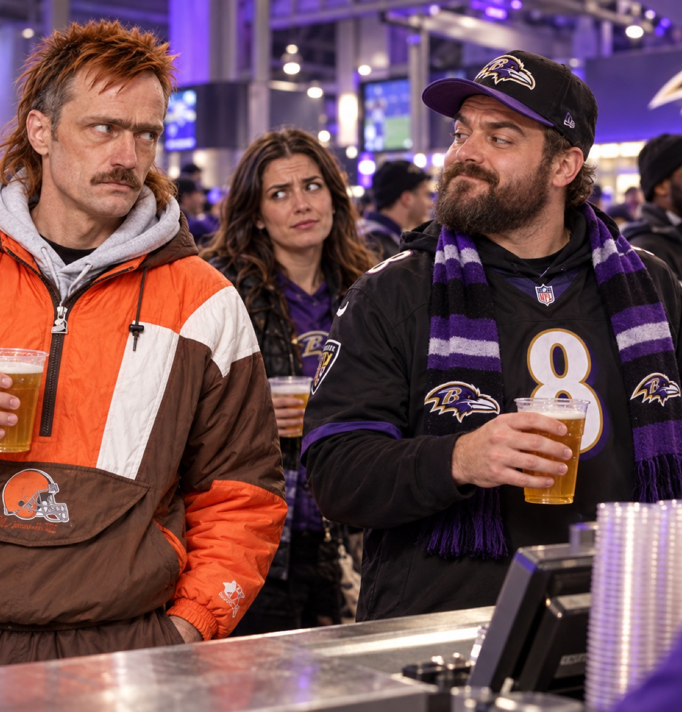
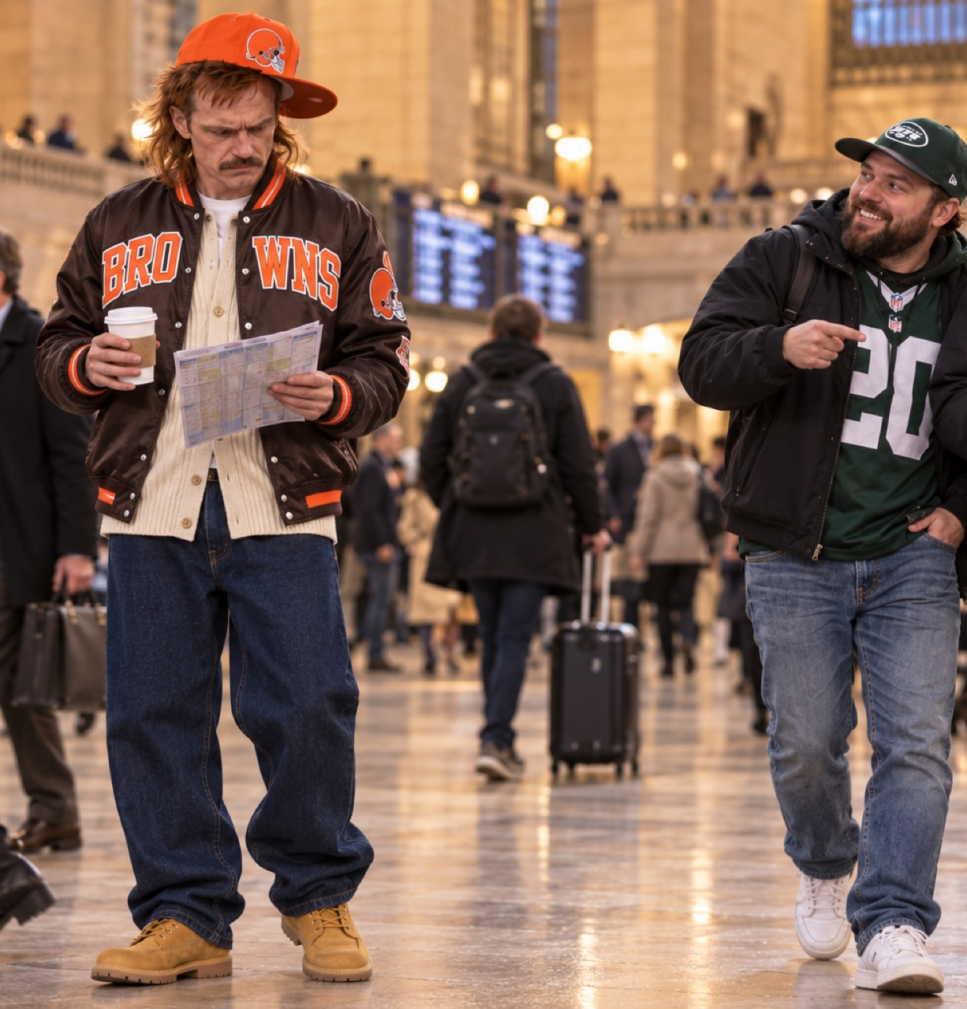
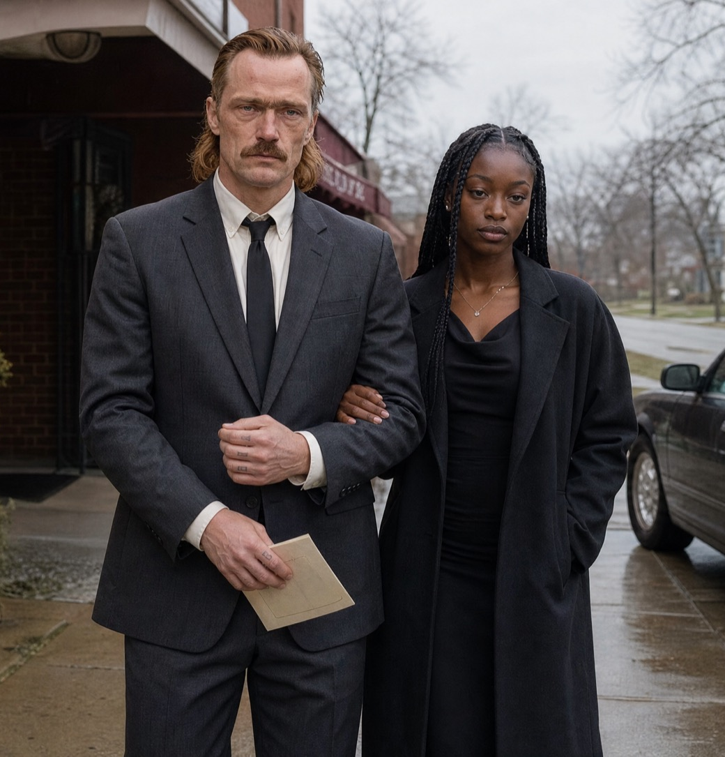
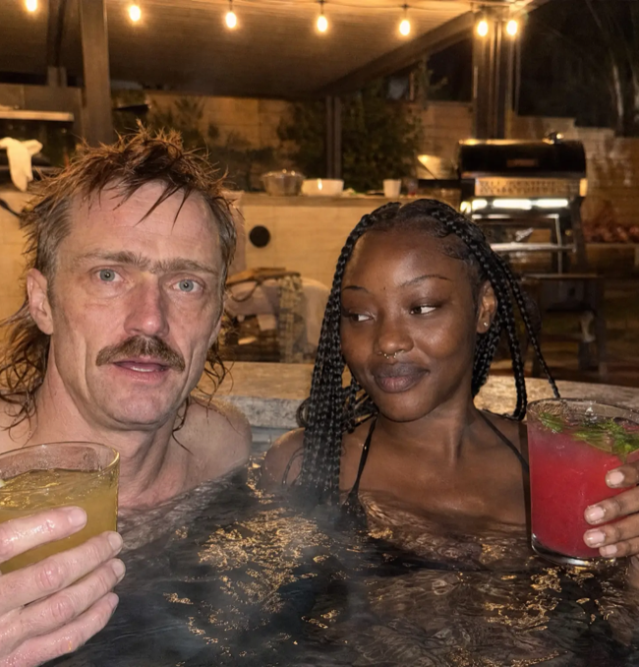
THE PROGRAMMING RHYTHM
A SEASON, NOT A SINGLE POST
Each week can move through distinct moments while preserving one continuous life.
REACTION
ROUTINE
RELATIONSHIP
CONSEQUENCE
A sharp response to the last result.
The local life that makes the character familiar.
People around the character gain history too.
A choice creates the next story beat.
NOT REAL FANS / DIGITAL FAN EXPANSION CONCEPT
CONCEPT ONLY / NO TEAM OR LEAGUE AFFILIATION
06
Notes:
The four beats illustrate a repeatable editorial rhythm, not a fixed calendar.
Images: /Users/mcricks/Desktop/AI/NFL/assets/Browns/Codex Image Oct 6, 2026, 10_17_27 PM.png; /Users/mcricks/Desktop/AI/NFL/assets/Browns/Codex Image Oct 6, 2026, 10_47_35 PM.png; /Users/mcricks/Desktop/AI/NFL/assets/Browns/hf_20261009_151913_957951c7-6581-4367-9759-91211be65fb4.png; /Users/mcricks/Desktop/AI/NFL/assets/Browns/composite5.png

Slide 7
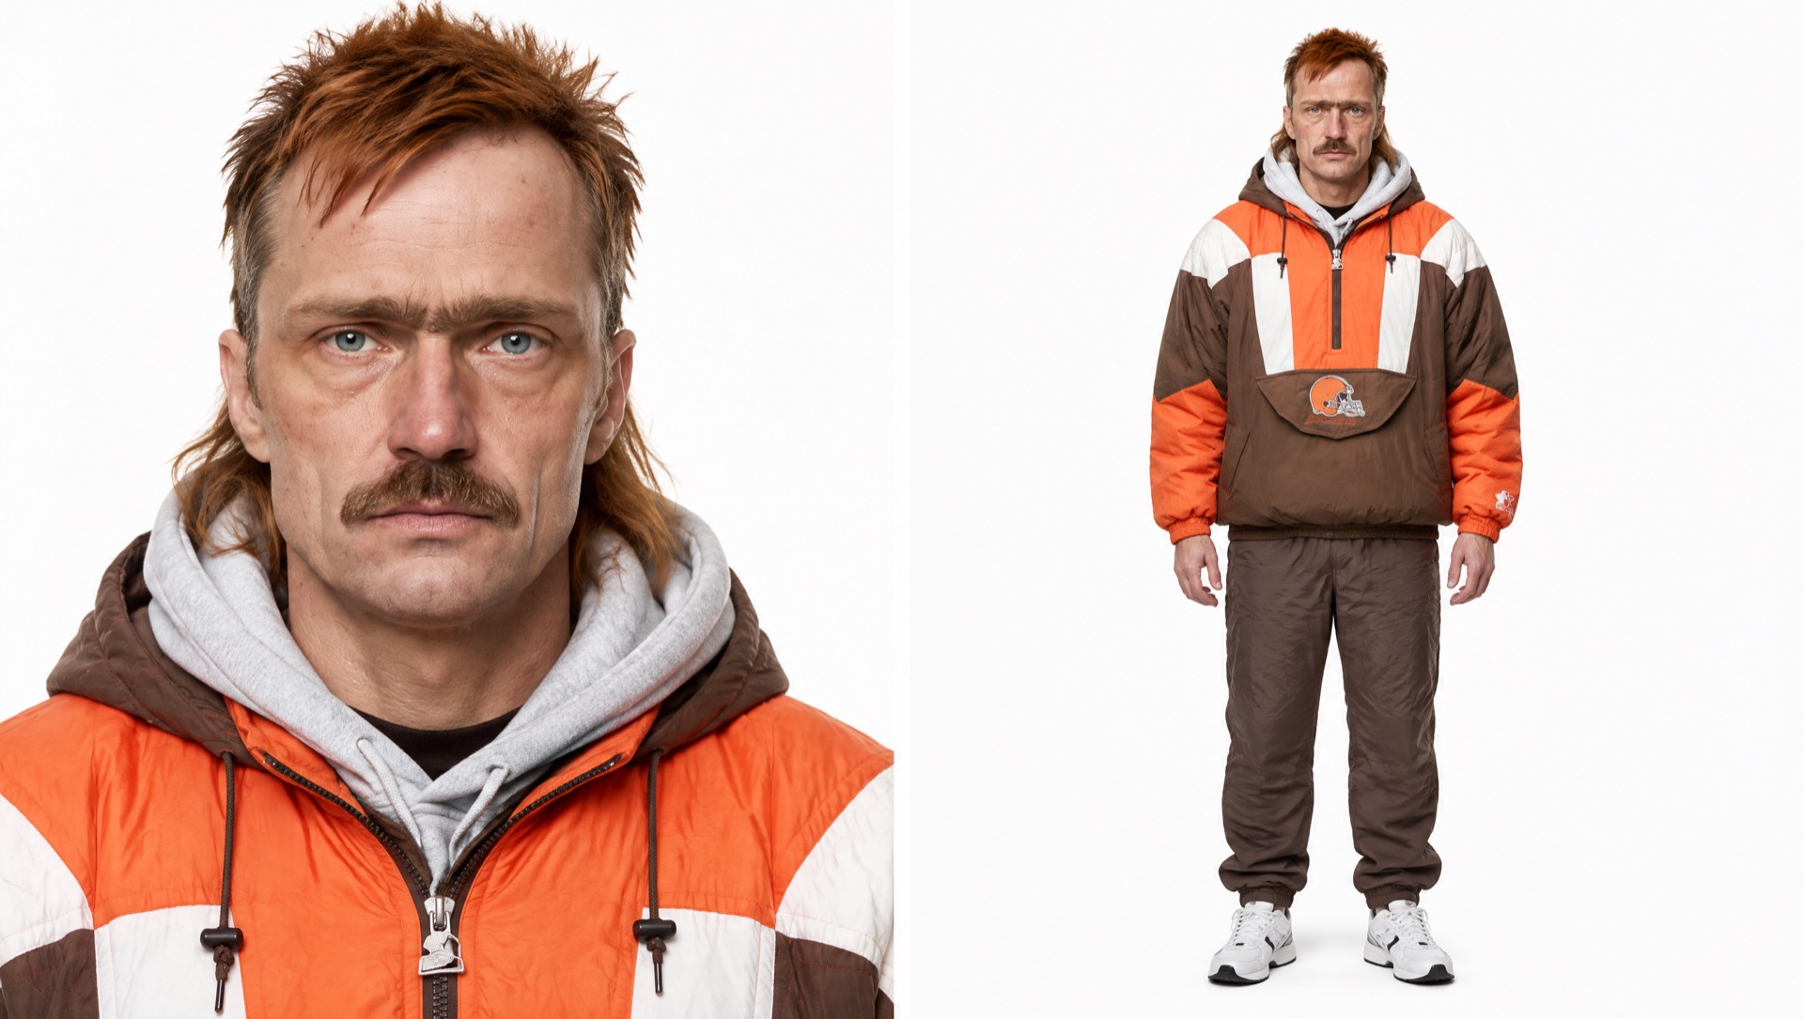
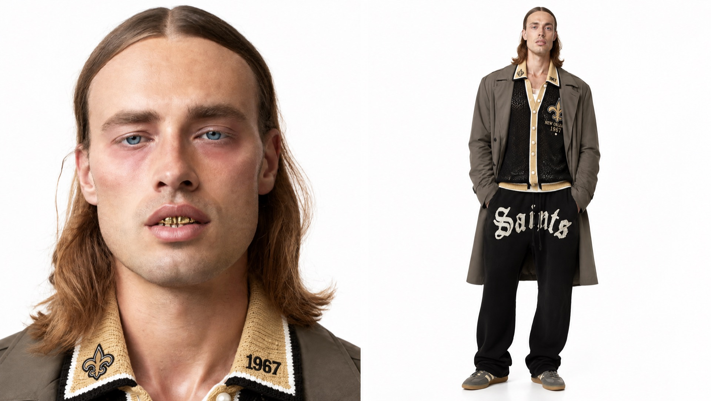
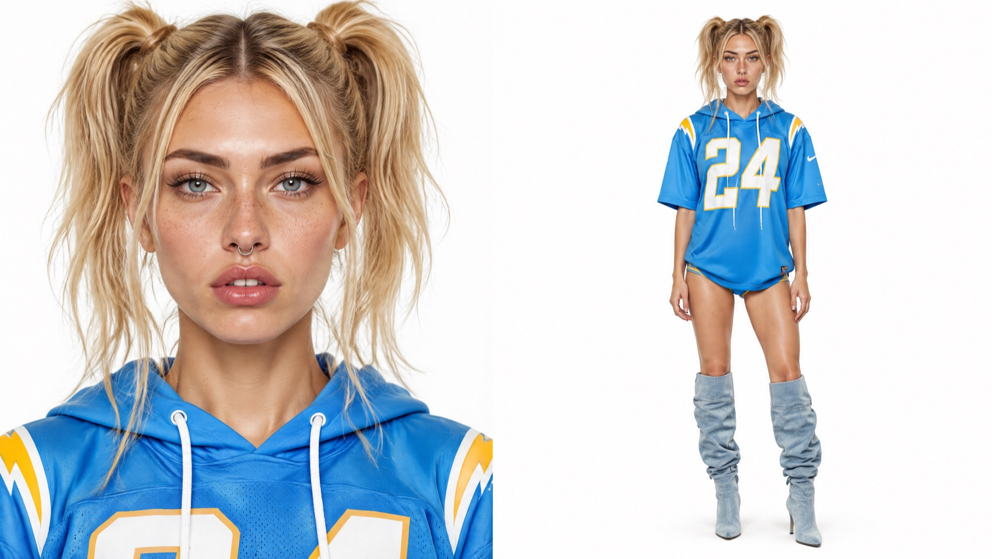
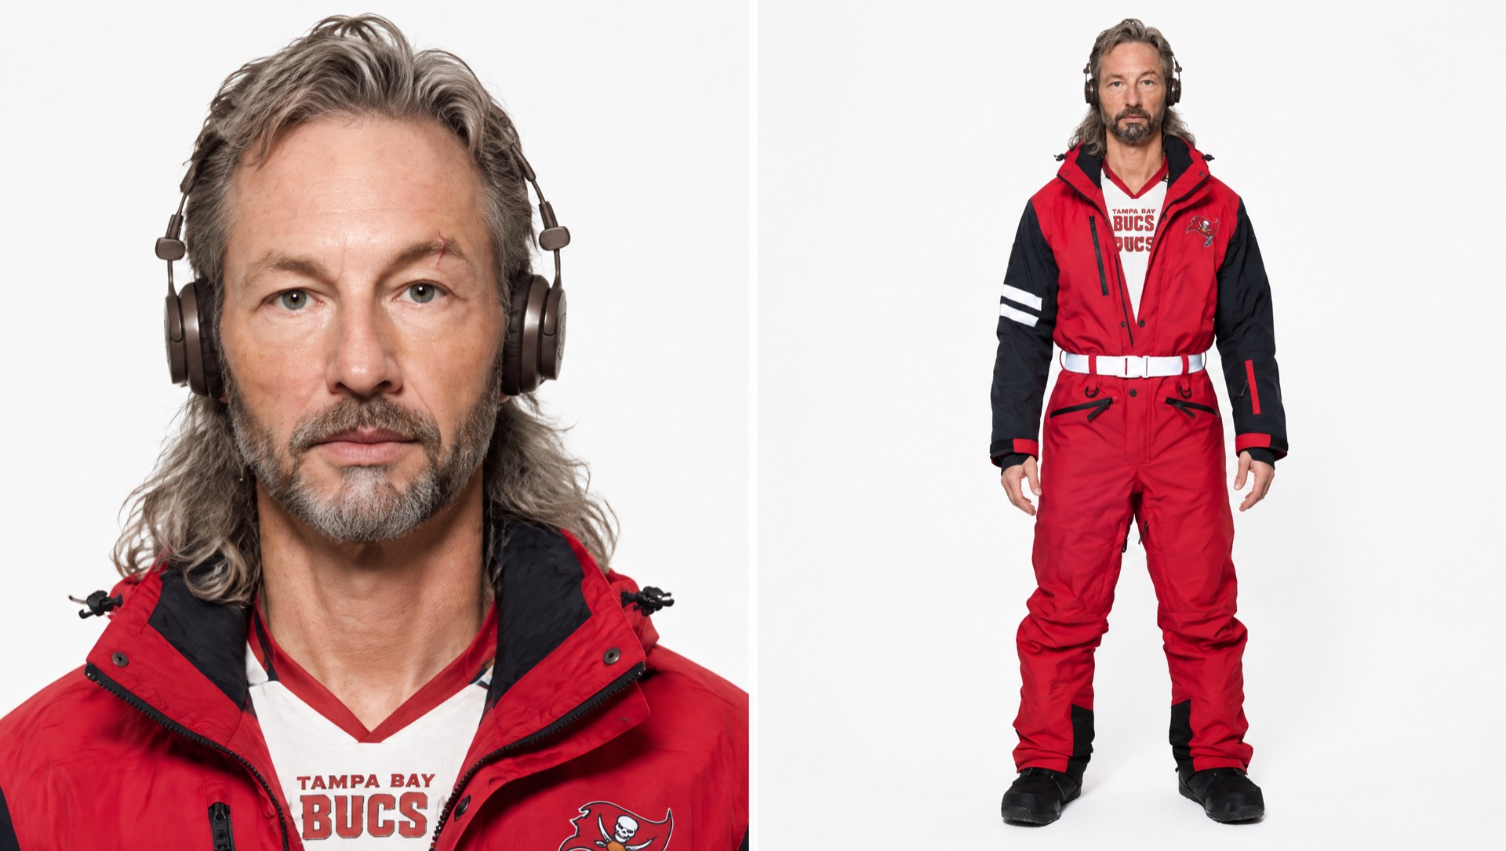
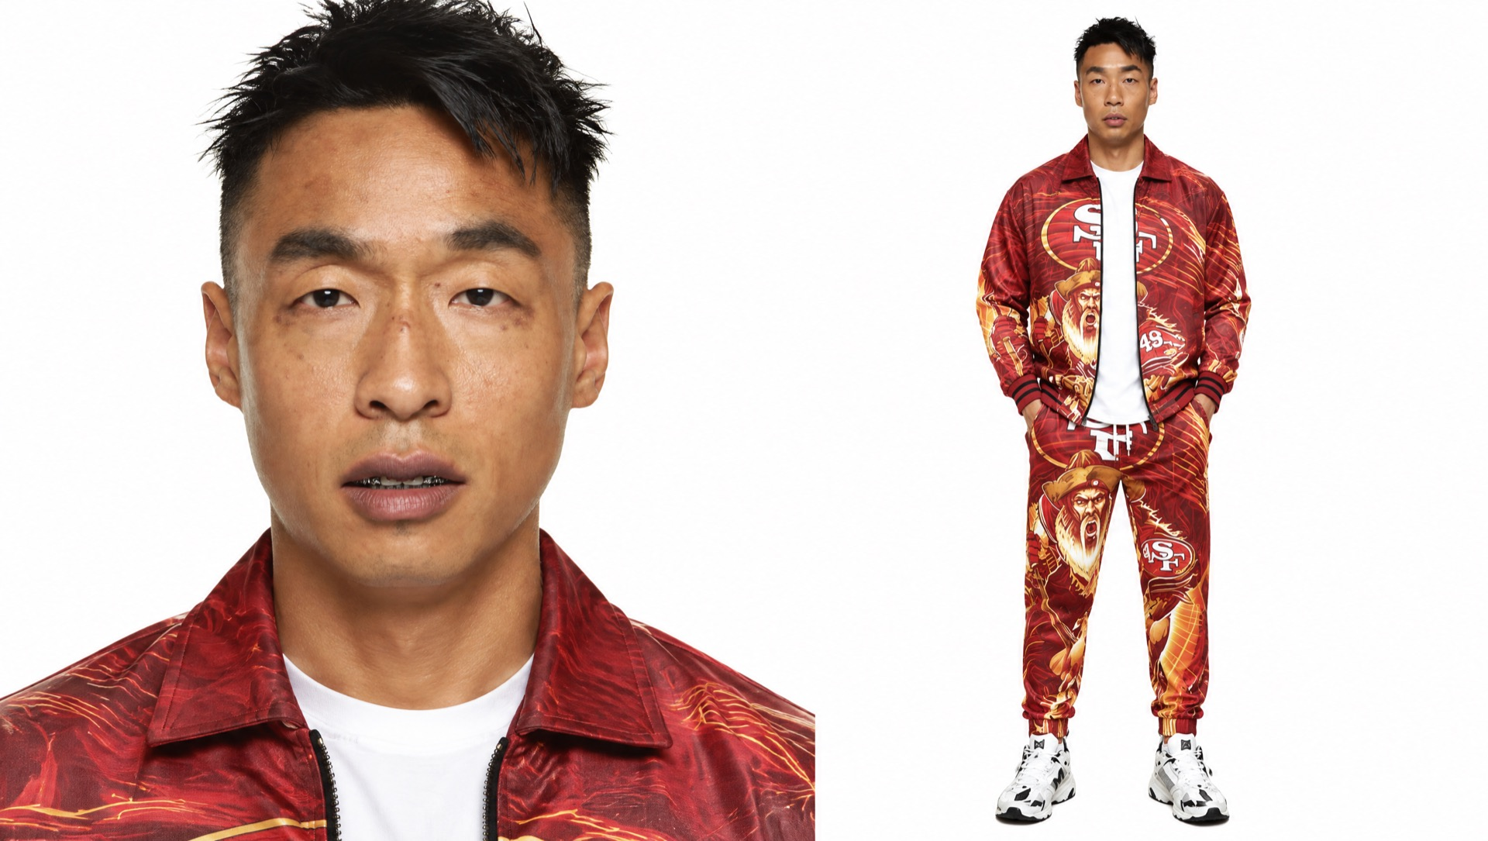
THE CHARACTER NETWORK
FIVE CHARACTERS, ONE SHARED SYSTEM
Each local keeps a distinct look and point of view. The same continuity rules hold the larger world together.
CLEVELAND
NEW ORLEANS
LOS ANGELES
Daz
Visual direction
Visual direction
TAMPA BAY
SAN FRANCISCO
Visual direction
Visual direction
NOT REAL FANS / DIGITAL FAN EXPANSION CONCEPT
CONCEPT ONLY / NO TEAM OR LEAGUE AFFILIATION
07
Notes:
One white-background character image is shown for each existing NFL asset folder that contains a generated character sheet.
Only Daz is presented as an established character. The remaining images are labeled as visual directions.
Images: /Users/mcricks/Desktop/AI/NFL/assets/Browns/hf_20261006_220007_3879fe5e-7b0c-442b-b03f-21f5c08b1c7e.png; /Users/mcricks/Desktop/AI/NFL/assets/Saints/hf_20261006_225731_fa29fae6-c579-4bab-91b8-7af962445207.png; /Users/mcricks/Desktop/AI/NFL/assets/Chargers/hf_20261007_202309_52c49f6e-5e14-474a-8edc-dcd540fdf5b1.png; /Users/mcricks/Desktop/AI/NFL/assets/Bucs/hf_20261007_213424_0d47aaa7-b882-42e1-bd51-08eb1386e773.png; /Users/mcricks/Desktop/AI/NFL/assets/49ers/hf_20261007_185148_da32551c-55e1-4dba-8acf-b9c2bf9ece6b.png

Slide 8
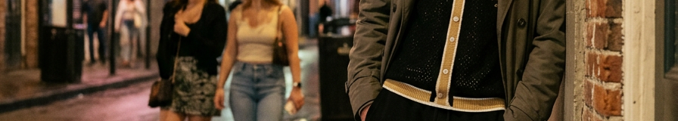
HOW IT GETS MADE
ONE CHARACTER KIT BECOMES A WEEK OF CONTENT
The workflow is repeatable because each post starts from the same locked identity, then adds one new story beat.
REFERENCE
01
LOCK THE CHARACTER
Reference sheet, voice, relationships and boundaries.
02
WRITE THE BEAT
One local truth, one emotional turn and one open loop.
03
BUILD THE MOMENT
Still, reel, reaction or reply—using the same identity.
04
CARRY IT FORWARD
IN-WORLD MOMENT
Log what changed so the next episode remembers it.
NOT REAL FANS / DIGITAL FAN EXPANSION CONCEPT
CONCEPT ONLY / NO TEAM OR LEAGUE AFFILIATION
08
Notes:
The slide demonstrates a simple reference-to-scene workflow with a non-Daz character.
Reference image: /Users/mcricks/Desktop/AI/NFL/assets/Saints/hf_20261006_225731_fa29fae6-c579-4bab-91b8-7af962445207.png
In-world image: /Users/mcricks/Desktop/AI/NFL/assets/Saints/hf_20261007_230342_72933f53-e080-4f17-b7c0-e615f4f84258.png

Slide 9
THE REPLICATION KIT
REPEAT THE SYSTEM, NOT THE PERSONALITY
Every city gets a different human truth. The production structure stays consistent.
01
VISUAL IDENTITY
02
VOICE RULES
03
LOCAL TEXTURE
Face, wardrobe, posture and a small set of repeatable locations.
Vocabulary, rhythm, humor and the lines the character will not cross.
Neighborhood details, rituals and cultural cues that feel specific.
04
RELATIONSHIP MAP
05
CONTENT RHYTHM
06
CONTINUITY LOG
Friends, rivals and family who create reasons for another episode.
A small menu of repeatable formats that can flex with the season.
A lightweight record of choices, callbacks and unresolved threads.
NOT REAL FANS / DIGITAL FAN EXPANSION CONCEPT
CONCEPT ONLY / NO TEAM OR LEAGUE AFFILIATION
09
Notes:
The six-part kit shows why the concept can be replicated without making every character feel like Daz.
Continuity is the shared operating system; personality and local texture remain distinct.

Slide 10
HOW THE WORLD GROWS
EACH NEW LOCAL ADDS ANOTHER WAY IN
Continuity compounds across characters: a callback in one city can become discovery in another.
01
ONE LOCAL
02
TWO LOCALS
03
CROSSOVER
04
SEASONAL WORLD
A clear point of view earns recognition.
Contrast creates rivalry and curiosity.
A shared beat transfers attention.
The audience discovers adjacent characters.
THE SCALING ADVANTAGE
New characters create more stories without erasing the memory already earned.
NOT REAL FANS / DIGITAL FAN EXPANSION CONCEPT
CONCEPT ONLY / NO TEAM OR LEAGUE AFFILIATION
10
Notes:
The growth model is additive: each local has an individual point of view and can participate in cross-character stories.
Images: /Users/mcricks/Desktop/AI/NFL/assets/Saints/hf_20261006_225731_fa29fae6-c579-4bab-91b8-7af962445207.png; /Users/mcricks/Desktop/AI/NFL/assets/Chargers/hf_20261007_202309_52c49f6e-5e14-474a-8edc-dcd540fdf5b1.png; /Users/mcricks/Desktop/AI/NFL/assets/Bucs/hf_20261007_213424_0d47aaa7-b882-42e1-bd51-08eb1386e773.png; /Users/mcricks/Desktop/AI/NFL/assets/49ers/hf_20261007_185148_da32551c-55e1-4dba-8acf-b9c2bf9ece6b.png

Slide 11
THE FIRST TEST
A 90-DAY AUDIENCE TEST
The goal is to learn whether people return for the character and participate in the story.
01
02
03
DAYS 1–30
DAYS 31–60
DAYS 61–90
ESTABLISH DAZ
INVITE THE CROWD
TEST THE WORLD
Publish a clear weekly rhythm. Repeat faces, locations and unresolved story beats.
Ask for lines, rituals and next-episode ideas. Let the audience vote on approved options.
Introduce one exploratory local and use a crossover to see whether attention transfers.
WHAT TO WATCH
Returning viewers
Comments that reference prior episodes
Saves and shares
Idea submissions
Vote participation
NOT REAL FANS / DIGITAL FAN EXPANSION CONCEPT
CONCEPT ONLY / NO TEAM OR LEAGUE AFFILIATION
11
Notes:
This is a concept validation plan. It deliberately focuses on audience behavior and contains no financial projections.

Slide 12
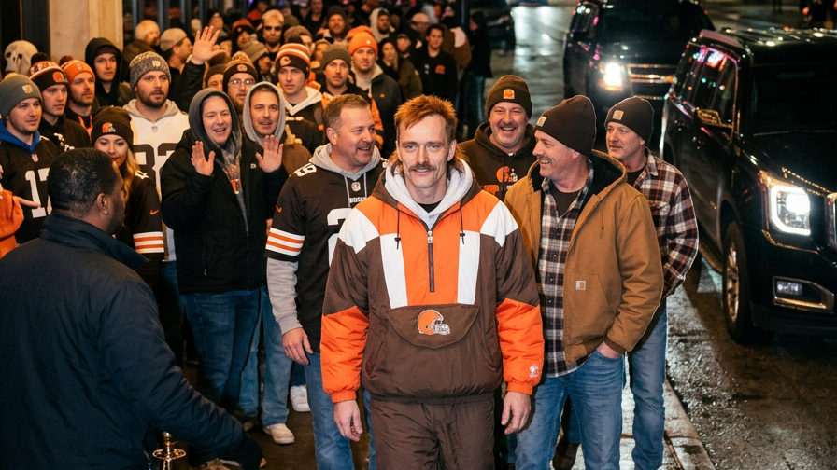
BUILD A PLACE
FANS RETURN TO
The reel introduces the character. The audience turns the character into a world.
WATCH HYPE VIDEO ↗
DAZ PROFILE ↗
@SMOKEDAWGCLE ↗
NOT REAL FANS / DIGITAL FAN EXPANSION CONCEPT
CONCEPT ONLY / NO TEAM OR LEAGUE AFFILIATION
12
Notes:
Closing idea: durable fan relationships come from recurring characters, shared memory and guided participation.
Higgsfield-created image: /Users/mcricks/Desktop/AI/NFL/assets/Browns/hf_20261007_231434_25c62d81-302c-4bca-9f28-f31bac9f0009.png
Brand asset: /Users/mcricks/Desktop/AI/NFL/AI_Influencer_Studio/Brand/Logo_Exploration/v2-mechanical-fan/not-real-fans-primary-transparent.png
Hype video: file:///Users/mcricks/Desktop/AI/NFL/AI_Influencer_Studio/Business/Not_Real_Fans_Investment_Deck/trailer/exports/Not_Real_Fans_Character_Pitch_v2.mp4
Daz profile: https://notrealfans.com/fans.html
Daz Instagram: https://www.instagram.com/smokedawgcle/

